Slide 1
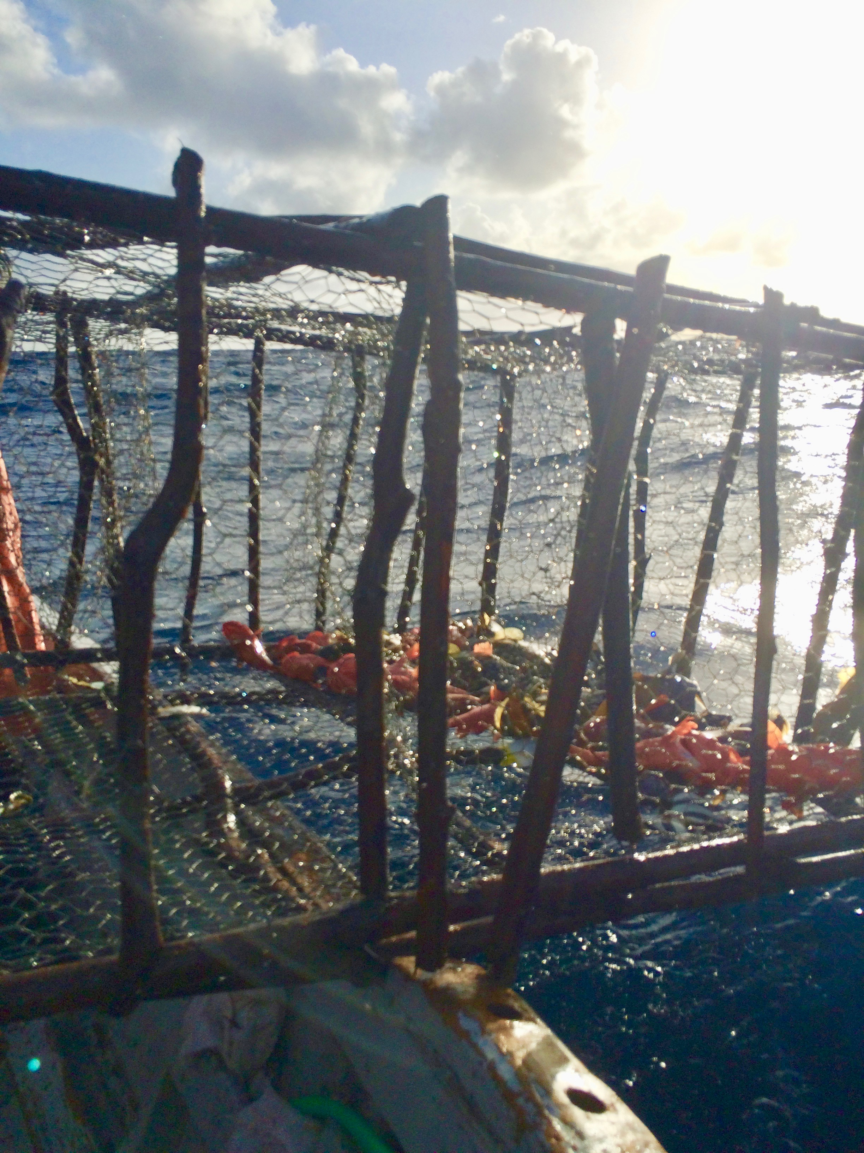
Biomass/Fishery Yield Projections of Management Scenarios in Montserrat’s Fisheries
July 19, 2017

Slide 2
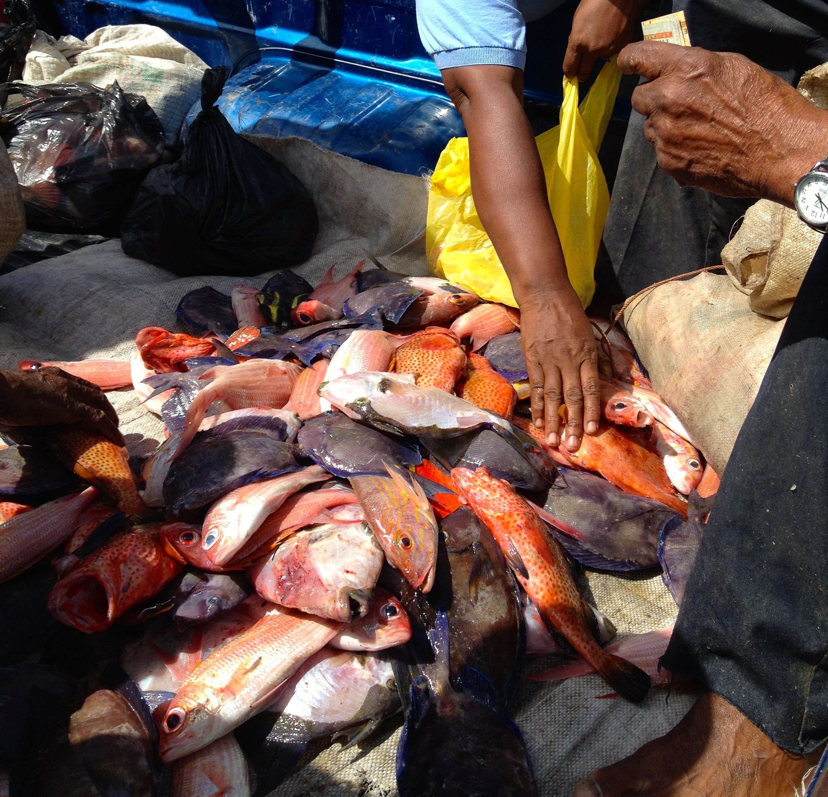
Methods
We calculated current fishing mortality rate (F) for each species using a length-based assessment method
Results indicate that blue tang, doctorfish, and silk snapper were currently experiencing overfishing
Old wife and red hind were not currently experiencing overfishing
We compiled life history parameters for each species:
vbk growth parameters
age/length of maturity
natural mortality
fecundity
adult movement
pelagic larval duration
maximum size/age

Slide 3
Methods
Then, we applied a spatial, age-structured model to each species to estimate biomass and fishery yields over the next 30 years under the following scenarios:
Scenario 1- Business as usual (BAU). The current estimated F continues into the future with no management changes
Scenario 2- 20% no-take reserve. The current estimated F continues into the future, but 20% of Montserrat’s waters are designated as no-take areas
Scenario 3- 30% no-take reserve. The current estimated F continues into the future, but 30% of Montserrat’s waters are designated as no-take areas
Scenario 4- Size limit. The current estimated F continues into the future, but a minimum size limit that is equal to the species length at maturity is implemented
Scenario 5- 30% no-take reserve and size limit. The current estimated F continues into the future, but 30% of Montserrat’s waters are designated as no-take areas AND a size limited that is equal to the species length at maturity is implemented

Slide 9
Conclusions
With no management intervention (scenario 1), species currently experiencing overfishing will experience a decline in biomass and fisheries yield over the next 30 years
How a species responds to each intervention will depend on it’s life history characteristics, movement patterns, and current exploitation status.
A minimum size and 30% no-take marine reserve (scenario 5) results in the largest increase in biomass across all species
Although fisheries yield decreases for a few years with a management intervention (scenarios 2-5), yield increases substantially after 5 - 15 years (depending on species)

Slide 10
Management Recommendations
Implement a 30% no take marine reserve and minimum size limit to increase biomass across all species and fisheries yield over time
To implement a minimum size effectively:
Escape gaps should be built into pots so that individual fish below the size at maturity can escape before the trap is brought to the surface.
Line fishers should carefully remove hook and release any fish below the size at maturity.
Spear fishers should not target individual fish that are below the size at maturity
Biodegradable twine should be used to attach one side of trap to avoid increased fishing mortality from ghost fishing.

